Slide 1
CONCURRENCY CONTROL
Module III

Slide 2
Coordination of the simultaneous execution of transactions in a multiuser database system.
Objective-To ensure the serialisability of transactions in a multi-user database environment.
Concurrency control is important as it can create several data integrity and consistency problems.

Slide 3
The three main problems are
  lost updates
  uncommitted data
  inconsistent retrievals.

Slide 4
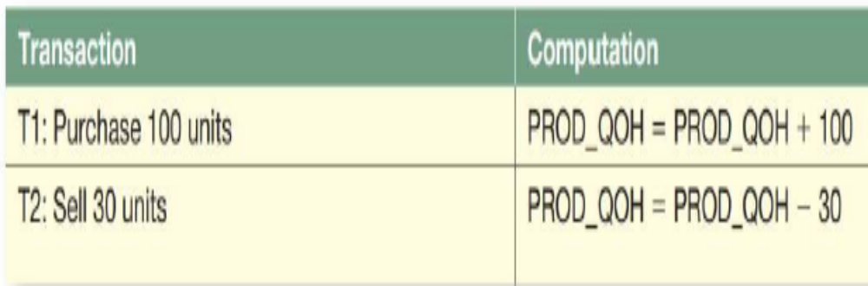
i. Lost Updates
It occurs when two concurrent transactions, T1 and T2, are updating the same data element and one of the updates is lost.

Slide 5
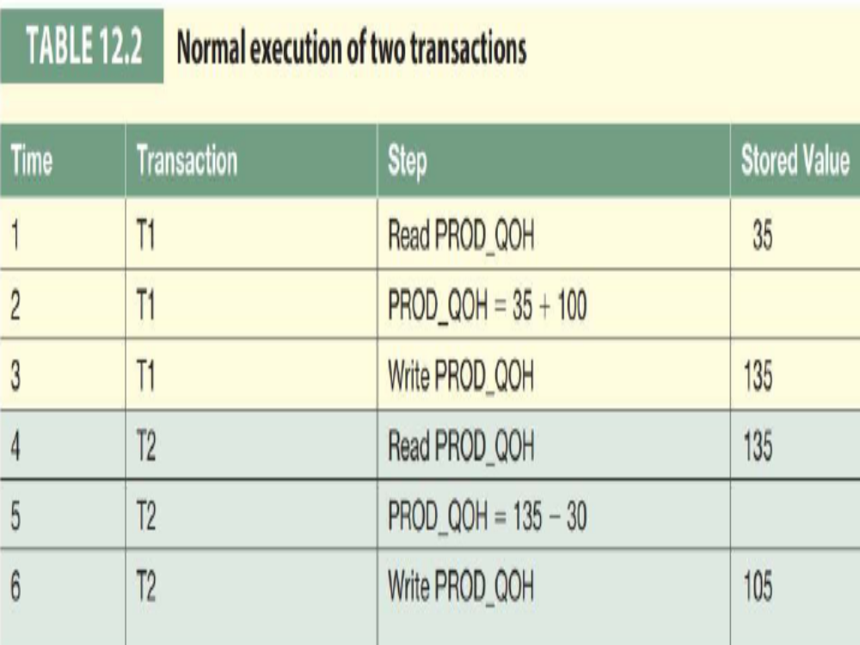

Slide 6
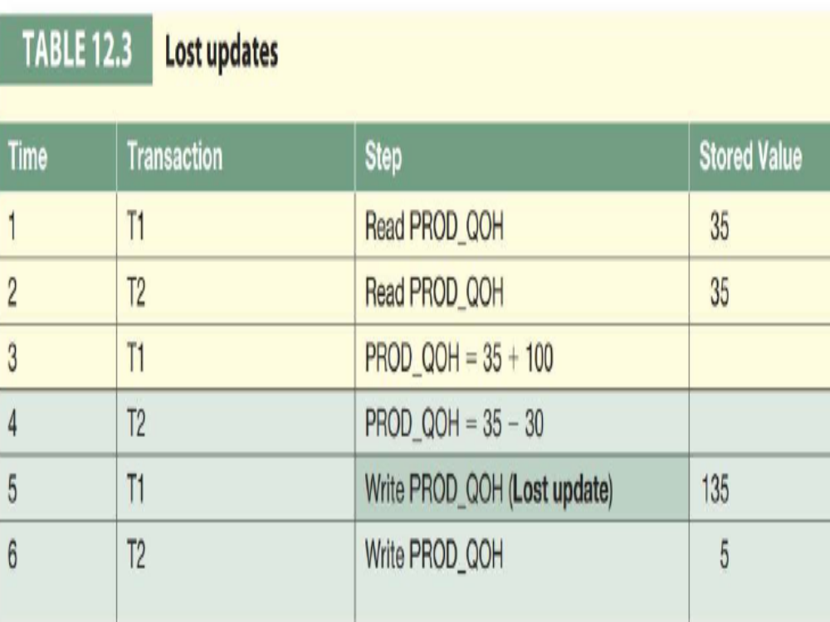

Slide 7
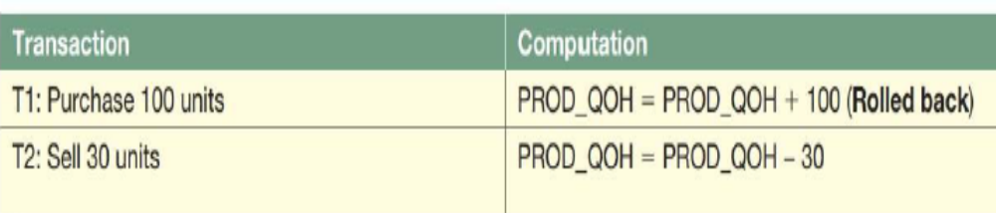
ii. Uncommitted Data
The phenomenon of uncommitted data occurs when two transactions, T1 and T2, are executed concurrently and the first transaction (T1) is rolled back after the second transaction (T2) has already accessed the uncommitted data thus violating the isolation property of transactions

Slide 8
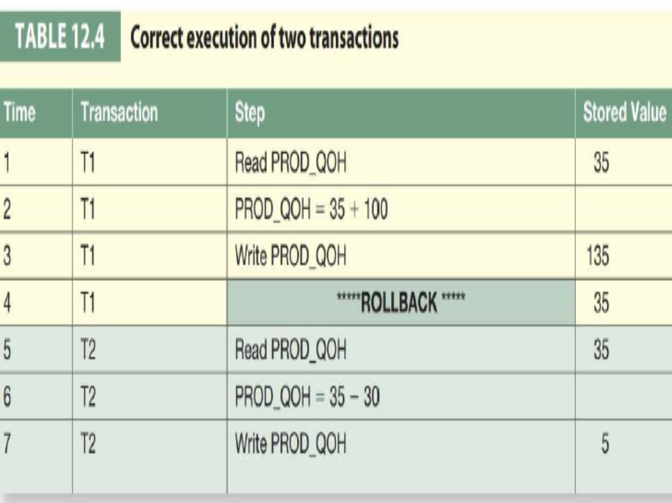

Slide 9
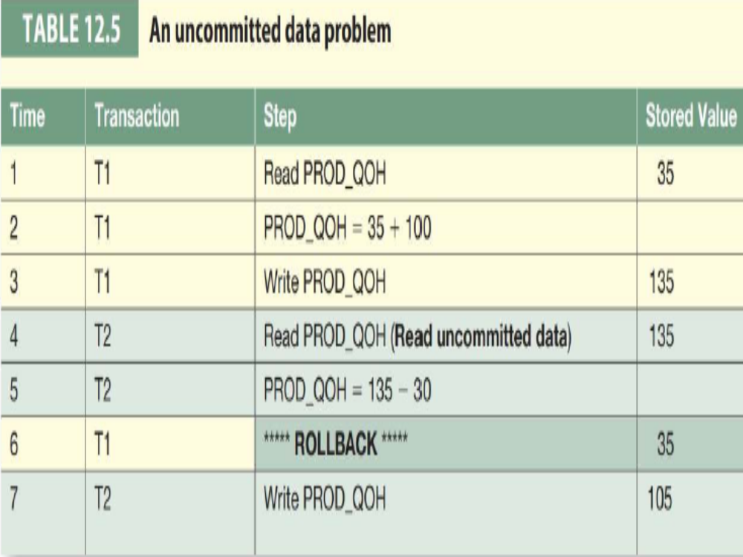

Slide 10
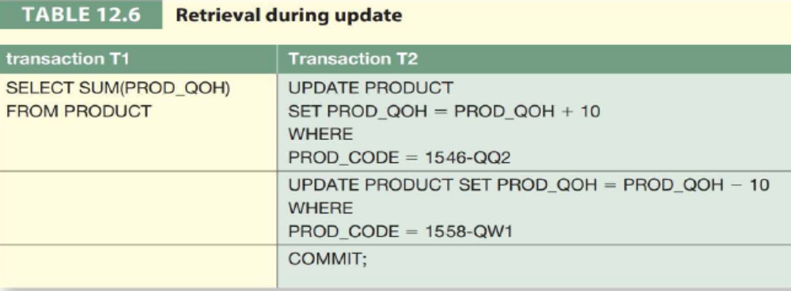
iii. Inconsistent Retrievals
Inconsistent retrievals occur when a transaction accesses data before and after one or more other transactions finish working with such data.

Slide 11
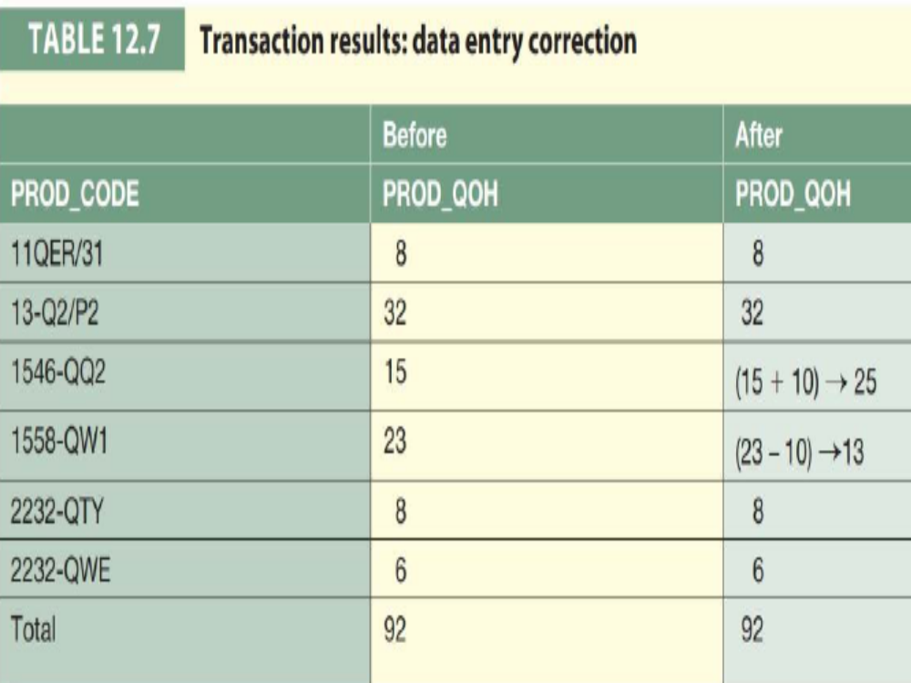

Slide 12
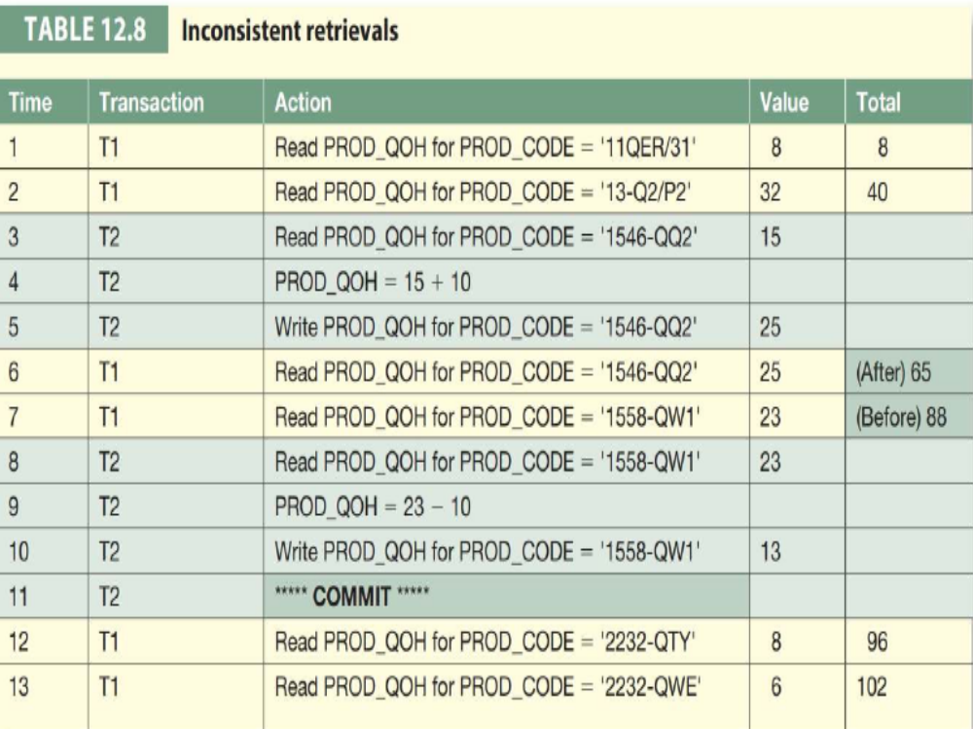

Slide 13
iv. The Scheduler
The scheduler is a special DBMS program that establishes the order in which the operations within concurrent transactions are executed.
The scheduler interleaves the execution of database operations to ensure serialisability and isolation of transactions.
To determine the appropriate order, the scheduler bases its actions on concurrency control algorithms, such as locking or time stamping methods.

Slide 14
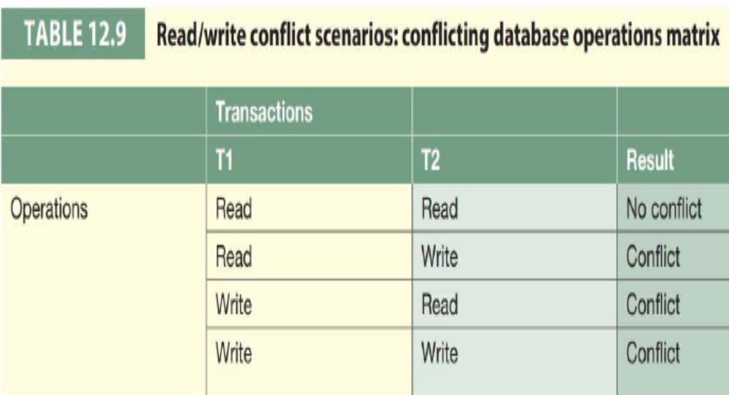
The scheduler also makes sure that the computers central processing unit (CPU) is used efficiently.

